Slide 1

Road Classification using Image Processing and Machine Learning
Mid mini-Project
by
Advait Shirvaikar | 221039017
Ananth Pai J | 221039025
Under the guidance of
Dr. Mohan Kumar Jayasubramanian (Associate Professor)
Manipal School of Information Science
28-12-2022

Slide 2
Presentation Outline
Introduction
Objective
Timeline
Literature Review
Proposed Model
Result
Conclusion
References
28-12-2022

Slide 3
Introduction
Types of Roads – Structured and unstructured
Focus of existing road recognition algorithms
Image processing and object detection techniques used
Machine Learning for classification of the road
28-12-2022
Notes:
1) This project is based on a binary classification problem, where we are trying to classify roads as structured or unstructured roads.
The defining factors that we have considered here, to differentiate the two are the edge lines of a road, that is, structured roads would be the ones which have well-defined edge lines or markings, and the unstructured roads won’t.
2) The existing road recognition algorithms are heavily focused on classifying and detecting different types of structured roads (multi-lane, single lane roads, highways, etc).
So with the help of these existing algorithms, our aim is to identify lanes on the road, and if these lanes are found, we classify the road as a structured road.
3) The classification part can be done with the help of Machine learning models, but first, the image needs to be pre-processed.
Pre-processing plays a vital role, as in this case, it will help in identifying the edge lines on the roads.
So, various image processing techniques such as thresholding, Sobel filtering, and Hough lines were used.
Apart from these, to identify and highlight the edge lines distinctively, the object detection technique ‘Sliding window search’ was used.
4) After a lane is detected, the resulting pre-processed image can be fed into a machine learning model such as a Convolutional Neural Network, to classify it as a structured road.
Similarly, if no lane is detected, it is classified as unstructured road.

Slide 4
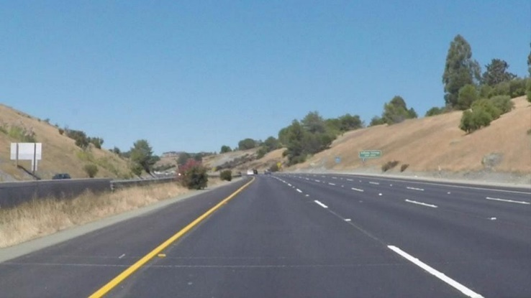
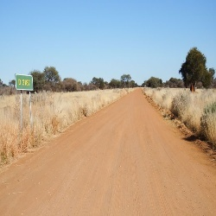
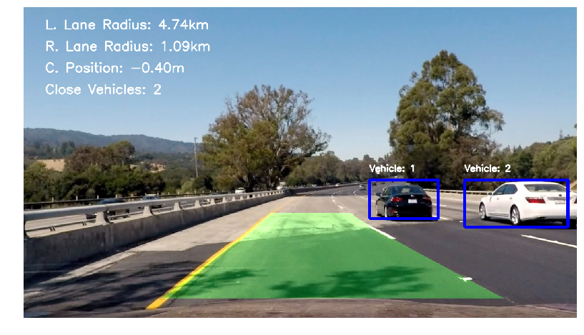
Introduction
Structured Road
Unstructured Road
Self-driving car GUI
28-12-2022

Slide 5
Objective
To learn the characteristics of roads in India, and to collect data on the same.
To implement an algorithm that recognizes structured and unstructured roads, using image processing techniques.
To create a machine learning model that will classify as well as identify structured and unstructured roads.
28-12-2022

Slide 6
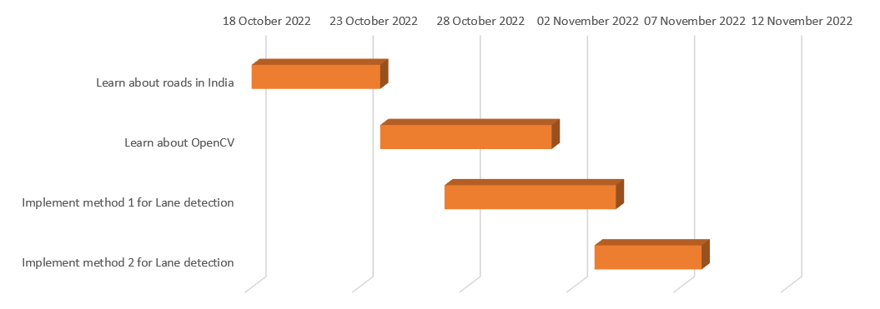
Timeline
28-12-2022

Slide 7
Literature Review
Analysis of Lane Detection Using OpenCV :
-S. K. Vishwakarma, A. and D. S. Yadav
They used Canny and Sobel detection techniques
They faced challenges due to
Different lighting and weather conditions
Curved roads
Unstructured roads
Other vehicles passing around
Different colour and textures
They concluded that Canny edge detection was better than Sobel in some cases and in other cases Sobel was better than Canny Edge
28-12-2022

Slide 8
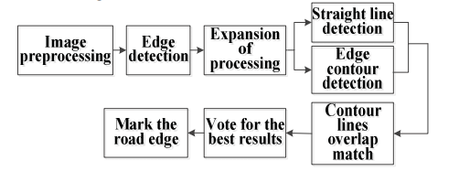
Literature Review
Unstructured Road Detection based on Contour Selection
-W. Xiang, Z. Juan and F. Zhijun
Because of Canny detection algorithm, unwanted cracks on the roads are highlighted
This produces a lot of irrelevant contours
Final detection will be very poor
They concluded by saying they needed better pre-processing
28-12-2022

Slide 9
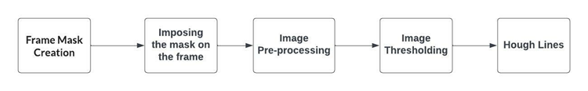
Proposed Model
Model 1: Using Hough Lines and Threshold masking
Flowchart for the proposed model
28-12-2022

Slide 10

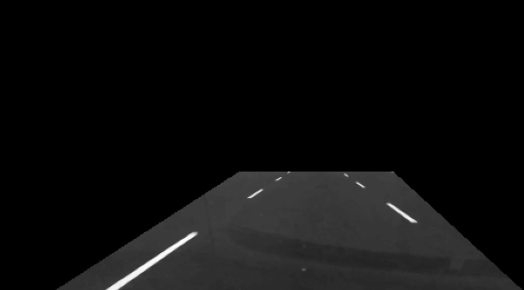

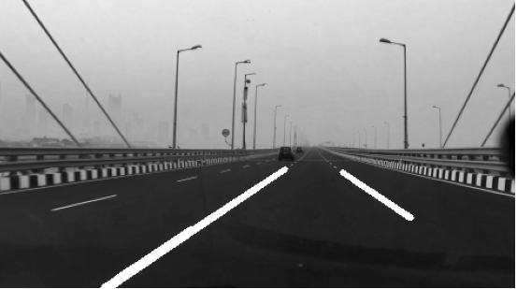
Proposed Model
Frame mask creation
Imposing the mask on the frame
Image Thresholding
Hough Line transform
28-12-2022

Slide 11
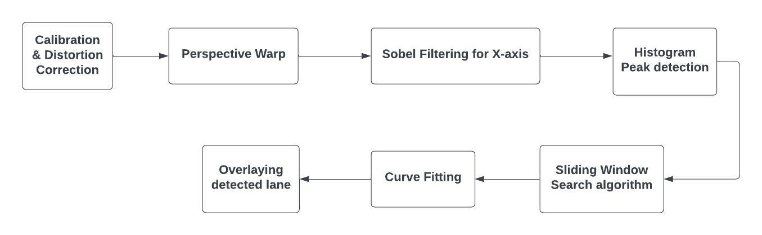
Proposed Model
Model 2: HSV Filtering and Sliding Window search
Flowchart for the proposed model
28-12-2022
Notes:
The HSV filter converts a color image into a binary black and white image. The color image is broken down into three channels, namely color (Hue), Saturation and brightness value.
A tolerance is specified for each of these channels.
If pixels lie within this tolerance, they appear white, and if they’re outside this range, they appear black in the binary image.

Slide 12
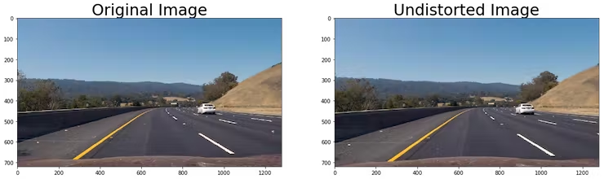
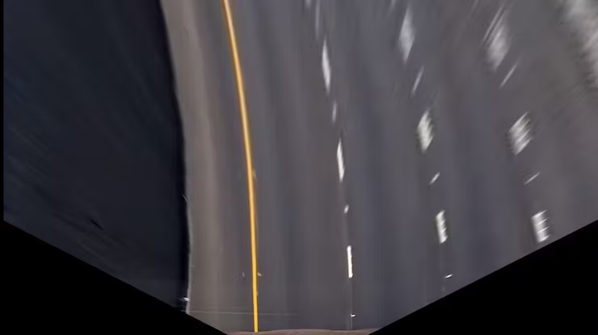
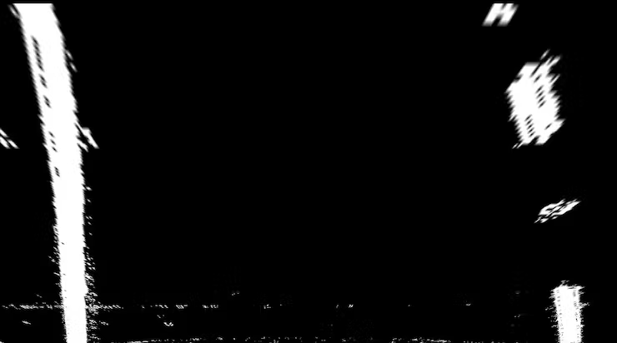
Proposed Model
Distortion Correction
Perspective Warped image
Sobel Filtering
28-12-2022
Notes:
Distortion correction:
Cameras often introduce significant radial or tangential distortion to images
To deal with this, OpenCV has a function called CalibrateCamera which give the distortion coefficients, and the camera matrix.
These distortion coefficients can then be used to correct the distortion using OpenCV’s undistort function.
Perspective Warp:
This helps to get the images in a bird’s eye view, instead of the curved front view, which makes it difficult to detect lanes.
This is done by geometric image transformations, specifically OpenCV’s getPerspectiveTransform and warpPerspective functions, which changes the viewpoint of the image.
Sobel Filtering:
Here the HSV colourspace was used, for the Lightness and saturation.
Sobel Operator matrix is used for detecting edges, and here, with the help of the Sobel Filter we get the first derivative of the image (this gives the intensity value across the image), and the places where derivative is maximum, are the ones with the edges. Instead of the entire image, we only focus on a portion of it, as shown.

Slide 13
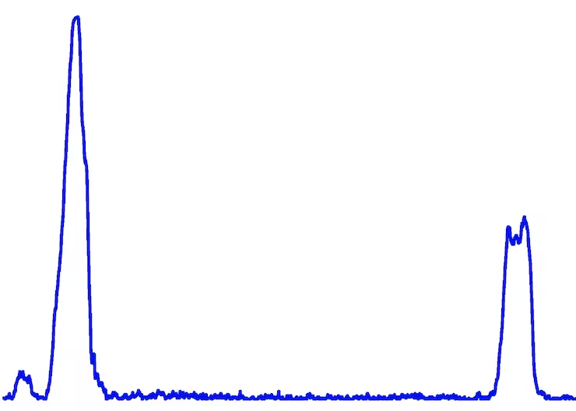
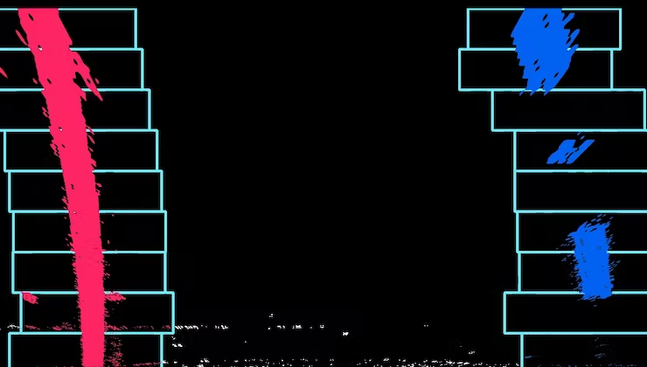
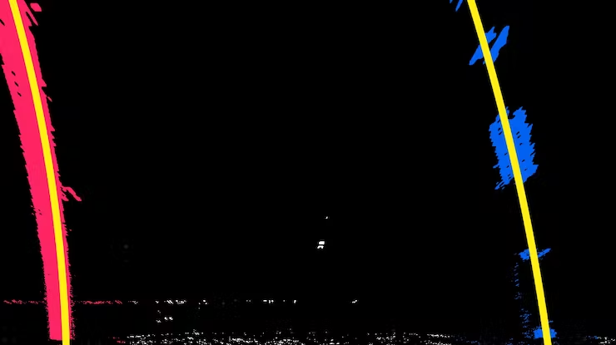
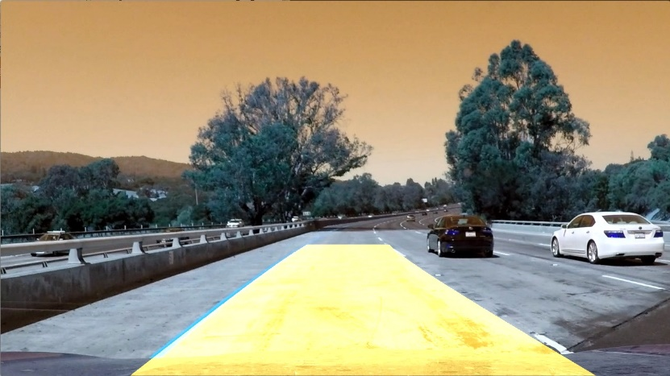
Proposed Model
Histogram Peak detection
Sliding Window technique
Curve fitting
Overlaying detected window
28-12-2022
Notes:
Histogram peak detection:
To detect the edges using the sliding window, a good starting point is required.
Each portion of the histogram depicts how many white pixels are in each column of the image.
The highest peaks of each lane are taken, for each lane.
Sliding window technique:
The sliding window algorithm is used to differentiate between the left and right lane boundaries so that we can fit two different curves representing the lane boundaries
Starting from the initial position, the first window measures how many pixels are located inside the window.
If the amount of pixels reaches a certain threshold, it shifts the next window to the average lateral position of the detected pixels.
This continues until the windows reach the other edge of the image.
Curve fitting:
To join all these edges on both sides, polynomial regression is used, using NumPy library’s polyfit function
Overlapping detected window:
This last part is optional, as we already have the lane lines. But by creating an overlay which fills the detected portion of the lane, it will become easier for the machine learning model to learn the difference between structured and unstructured roads.

Slide 14
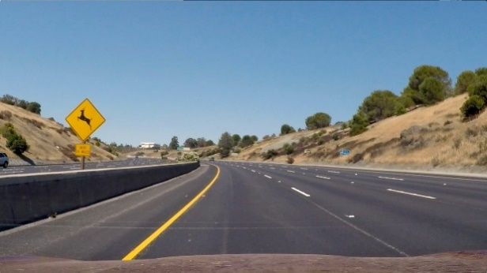
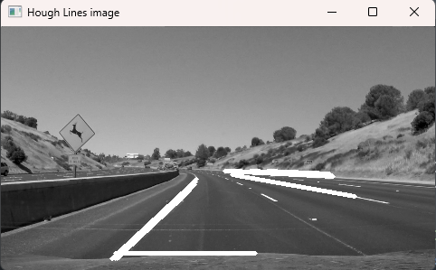
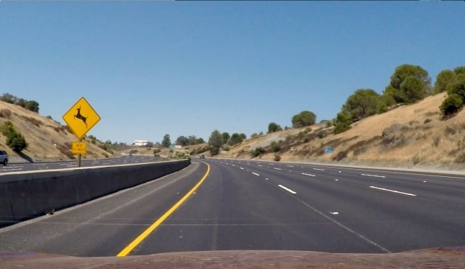
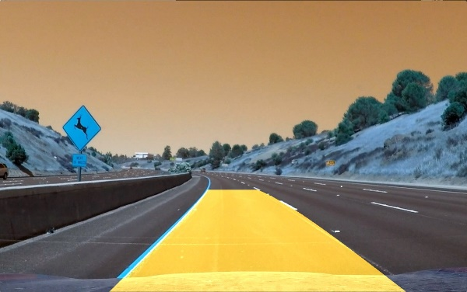
Result
Proposed Model 1
Input image
Final output
Proposed Model 2
Input image
Final output
28-12-2022
Notes:
As seen, the first model is able to detect some of the lane lines, but not all.
The model is not able to detect the dashed lines.
Also, creating an overlay for this model won’t be effective as the detected lines are not consistent, or even remotely parallel
As far as model 2 is concerned, using all the image processing an object detection that was described on the previous slides, a well defined and consistent lane can be detected.
As previously mentioned, the highlighted yellow overlay will play a crucial part in the next stage of machine learning.

Slide 15
Conclusion
Resulting output produced by model 2 was significantly more promising, for detection of structured roads.
Unstructured roads still require some pre-processing due to the inconsistency in the terrain and the lighting conditions
With some optimization, Model 2 (HSV Filtering and Sliding Window search) can be considered for the next stage, where a machine learning can classify structured roads.
28-12-2022

Slide 16
References
28-12-2022

Slide 17
Queries
&
Suggestions
28-12-2022

Slide 18
THANK YOU
28-12-2022

